Slide 1

The Agro Hub
Team: NewB

Slide 2
In the heart of all things green and the hustle of daily life, we're thrilled to introduce you to something special. At The Agro Hub, we're on a mission to bring the farm to your table, ensuring the freshest veggies make their way from our fields to your doorstep. Imagine a place where the goodness of homegrown produce meets the ease of technology. That's what The Agro Hub is all about – it's not just a website; it's a friendly middleman connecting hardworking farmers to your family's dinner. Get ready for a digital harvest that's fresh, convenient, and just a click away. Join us in this journey from farm to table, crafted just for you!
Welcome to The Agro Hub

Slide 3
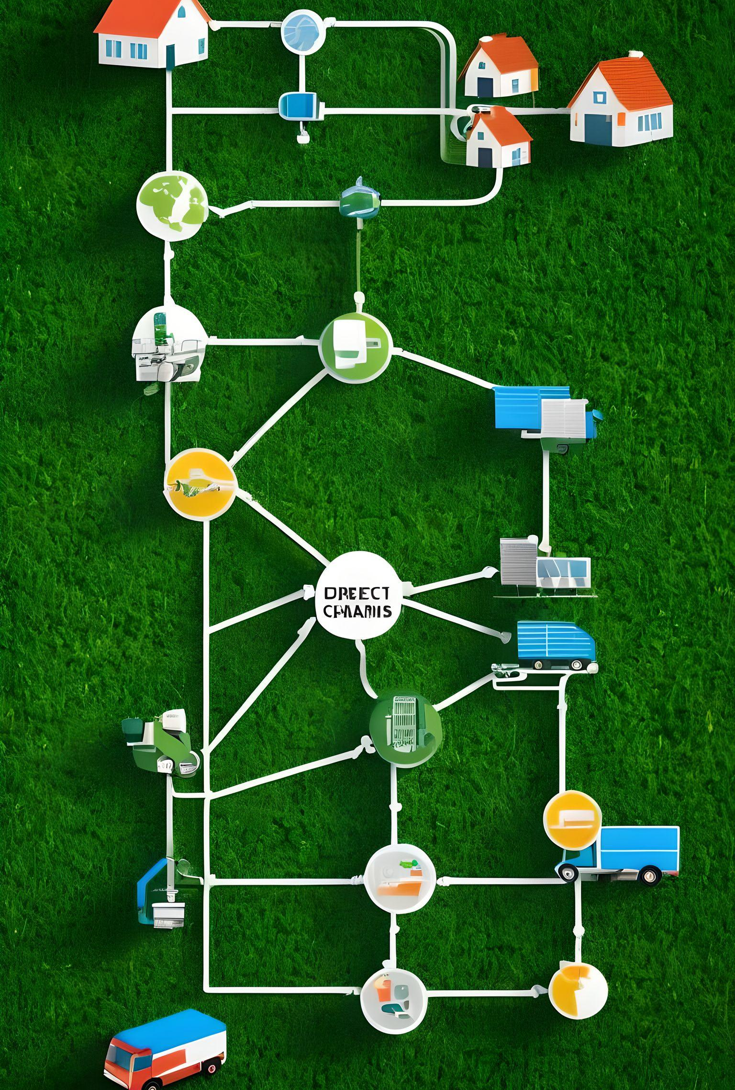
Statement of problem :
Limited Access to Fresh Produce.
Fragmented Agricultural Data Management.
Environmental Impact of Traditional Farming Practices.
Inefficient Farmer-to-Buyer Transactions.

Slide 4
How Will The Agro Hub Help Us: At The Agro Hub, we're on a mission to transform these challenges into opportunities that benefit everyone involved – farmers and consumers alike.
1. Limited Access to Fresh Produce and Inefficient Farmer-to-Buyer Transactions:**
-Direct Farmer-Consumer Connections.
-Streamlined Transactions.
2. Fragmented Agricultural Data Management:
-Unified Data Management.
3. Environmental Impact of Traditional Farming Practices.
-Promotion of Sustainable Farming.
In summary, The Agro Hub addresses these challenges by fostering direct connections, optimizing transactions, unifying data management, and promoting sustainability. It's a comprehensive solution that not only tackles current issues but also cultivates a more resilient and sustainable future for agriculture.

Slide 5
How does Agro Hub works :
1. User Registration:
- User registers for an account.
2. Browse Products:
- User explores available fresh produce.
3. Select Products:
- User chooses desired items.
4. Place Order:
- User proceeds to checkout and places the order.
5. Transaction Processing:
- System securely processes the transaction and confirms the order.
6. Delivery Coordination:
-The system coordinates the delivery logistics, providing real-time tracking information to the user.
7. Delivery to User:
- The Agro Hub manages the delivery, ensuring the fresh produce is delivered directly from the farm to the user's doorstep.
8. Cash on Delivery:
-Users have the option for cash on delivery.

Slide 6



Agile Methodology Agile is like having a super-flexible game plan for building your web platform. Instead of trying to figure out everything at the beginning, we break the project into small, manageable pieces. We work on these pieces one at a time, getting your feedback along the way. This way, we can adjust things quickly if needed, making sure we're always on track with what you actually want. It's like building your dream house room by room, making sure each part is just the way you like it before moving on to the next.
Software Development Methodology

Slide 7
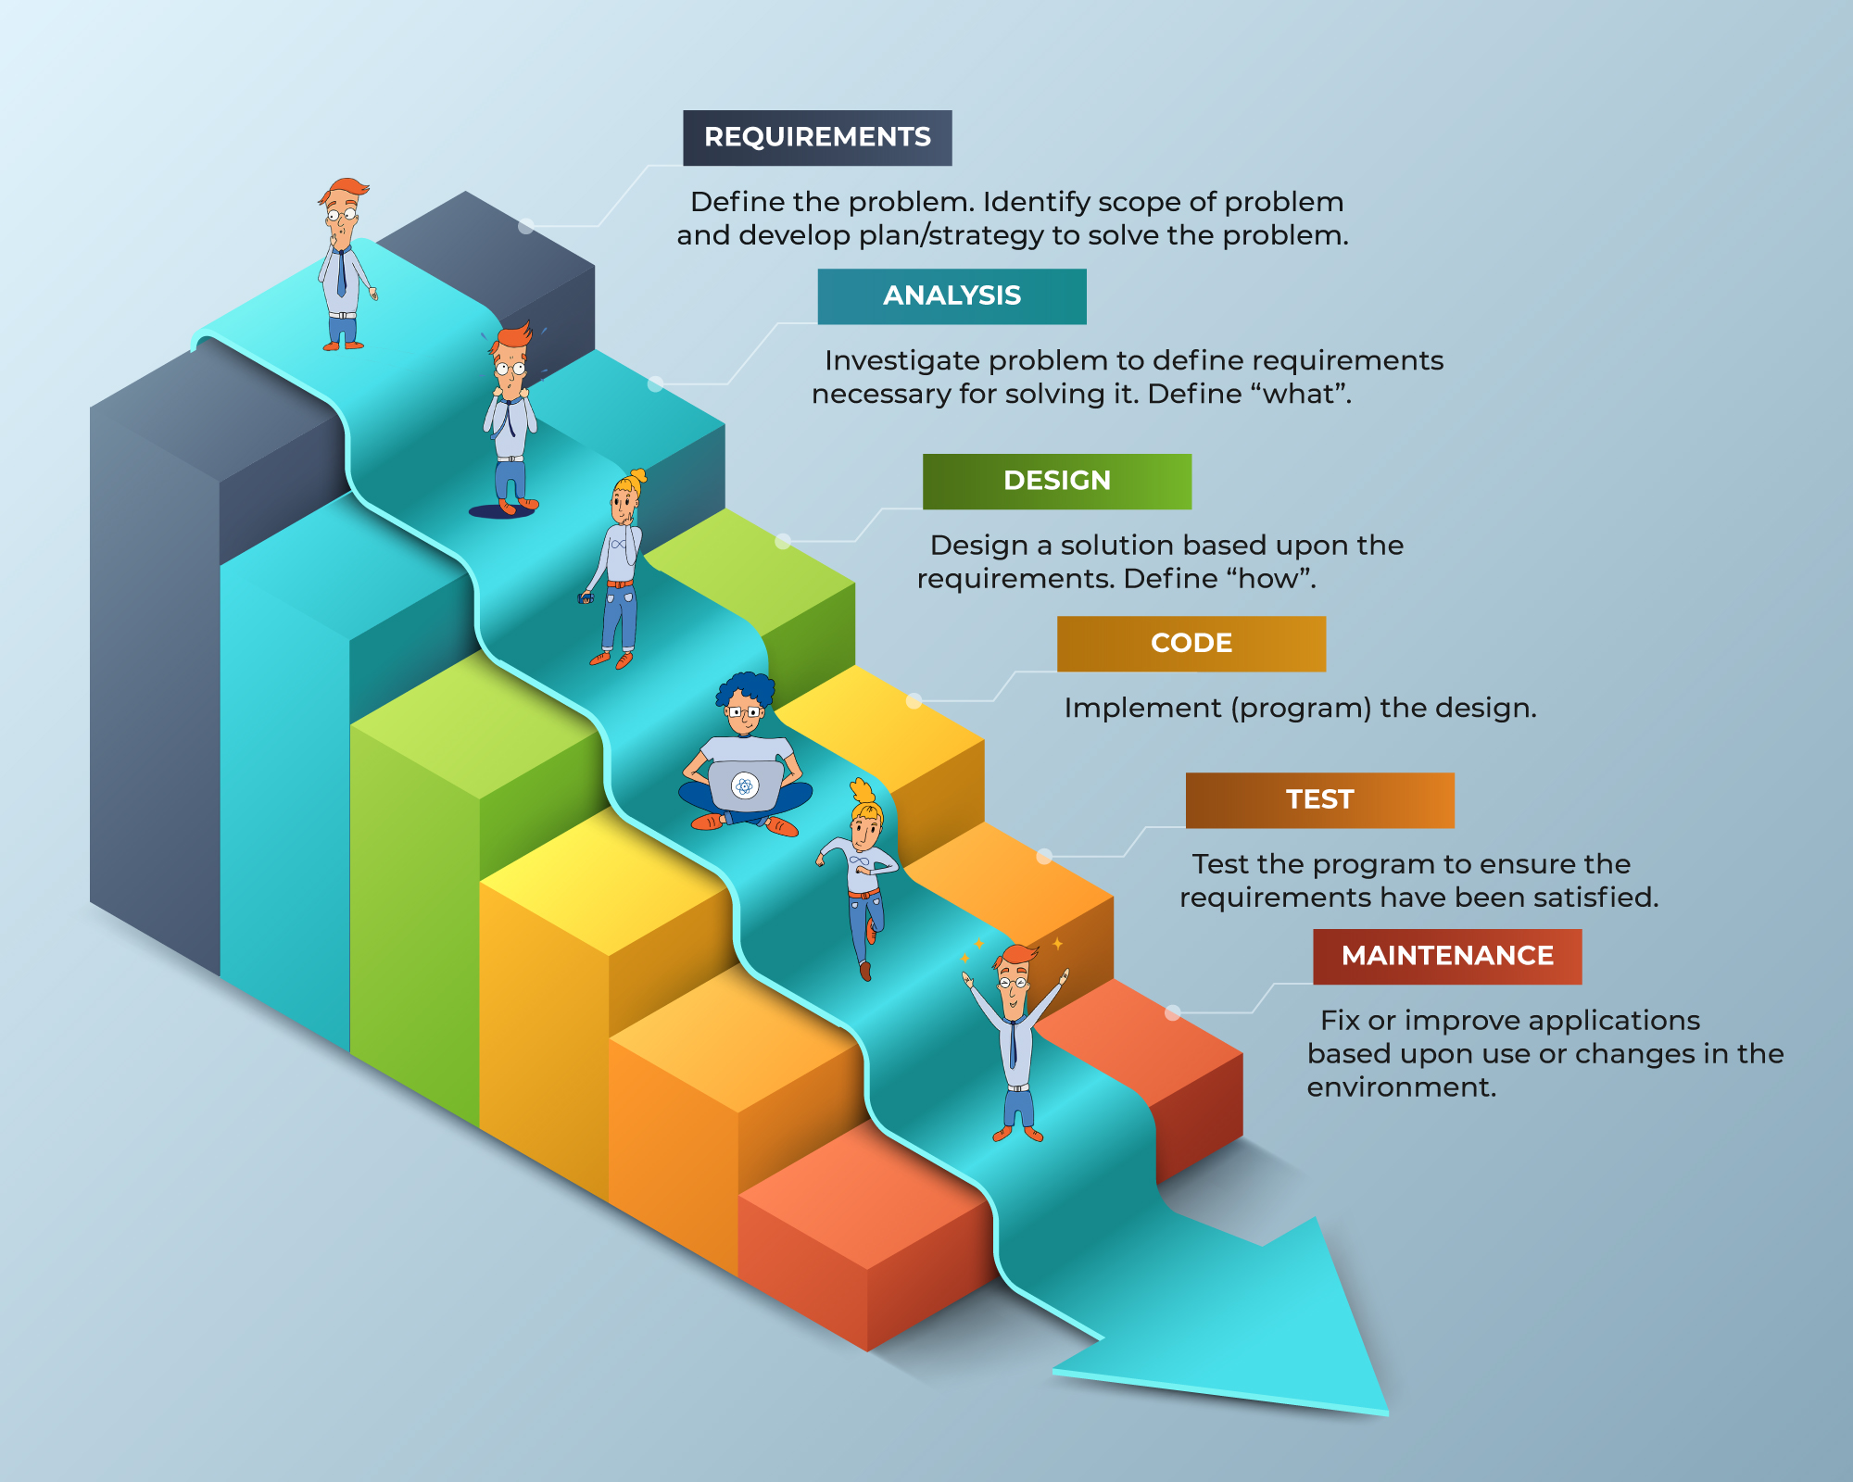
Waterfall Methodology:
The Waterfall methodology is a linear software development approach where the project progresses through defined phases sequentially. It starts with gathering and documenting requirements, followed by design, implementation, testing, deployment, and maintenance. Each phase must be completed before moving to the next, resembling a waterfall's downward flow. While it offers structure, changes are challenging once a phase is finished, making it less adaptable to evolving project needs.

Slide 8
_
Five Future enhancement for
1. Diverse Payment Options:
- Future Work :Integrate various payment methods, such as credit cards, digital wallets, and online banking, to offer users a range of convenient and flexible payment choices.
2. User Accounts and Profiles:
- Future Work: Develop user accounts and profiles to enhance the user experience. This can include order history, personalized recommendations, and a streamlined checkout process.
3. Mobile Application:
- Future Work: Consider developing a mobile application to extend accessibility and provide users with a seamless on-the-go shopping experience.
4. Enhanced Data Analytics:
- Future Work: Invest in advanced data analytics tools to gain insights into user behavior, preferences, and market trends. This information can inform strategic decisions and improve the overall platform.
5. Collaboration with Local Farmers:
- *Future Work:* Strengthen partnerships with local farmers to expand the variety of fresh produce available on the platform. This supports local agriculture and provides users with a more diverse selection.

Slide 9
Conclusion:
In creating this web platform, we've crafted more than just a website; it's a living connection between the fields and your dinner table, brought to life through the simplicity of HTML and CSS.
This project is for , supporting local farmers, and bringing transparency to food sourcing. By seamlessly blending technology with the hard work of our farmers, we've empowered them and brought joy to consumers.
Behind every click lies a story of sustainability and dedication. Our web platform is more than code; it's a celebration of the bond between those who cultivate the land and those who savor its bounty.
It's important to acknowledge the support we've received from various online sources and the use of a bit of JavaScript from external contributors. Together, with your support, we're cultivating connections, nurturing local farmers, and sowing the seeds of a brighter, more connected future from farm to table.

Slide 10
Reference:
The Agro Hub, is a web platform developed with HTML, CSS, and JavaScript, showcasing our team's proficiency in web development. It aims to revolutionize the agricultural supply chain by bridging the gap between farmers and customers.
Key features include farmers easily adding products, promoting local produce, and empowering farmers with a direct sales channel. This addresses crop wastage, ensuring fair compensation.
"The Agro Hub" strategically uses technology to promote sustainable agriculture, fostering a community that values healthy crops. The project demonstrates a commitment to making a positive impact on the agricultural sector with attention to detail, creativity, and dedication.
We The Agro Hub team Have created a more efficient and equitable agricultural ecosystem. For further inquiries, feel free to contact me.
Sincerely,
Team NewB

